Slide 1





















The class
diagram is a static
model that
shows the
in the
classes and the relationships system.
among
classes
Class diagrams illustrates classes, interfaces, and their associations. They are used for static object modeling.
A Class diagram gives an overview of a system by
showing its classes and the relationships among them.

Slide 2






The main building block of a class diagram is the class, which stores and manages information in the system.
A blueprint that an object made from.
The class contains two major parts:
Attributes “data members”.
Operations “method members”.

Slide 3


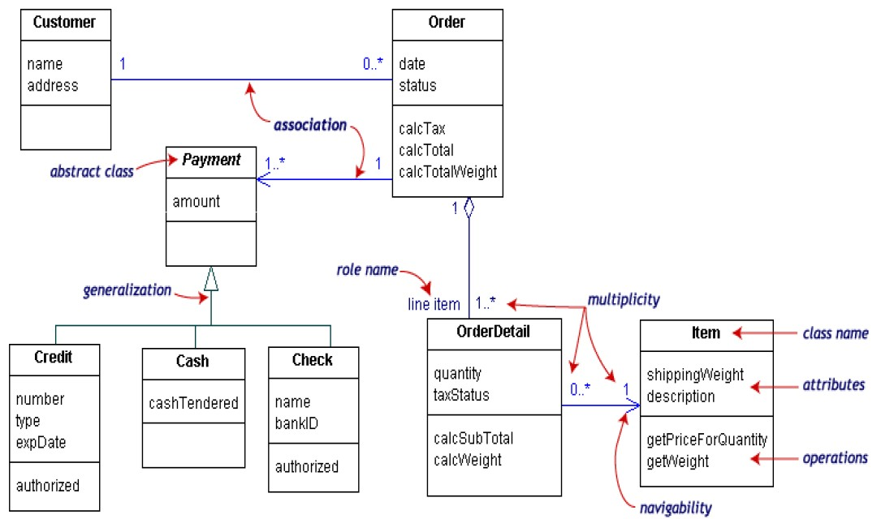
No arrows; info can flow in both directions
Aggregation
– Order
class classes.
contains OrderDetail Could be composition?

Slide 4

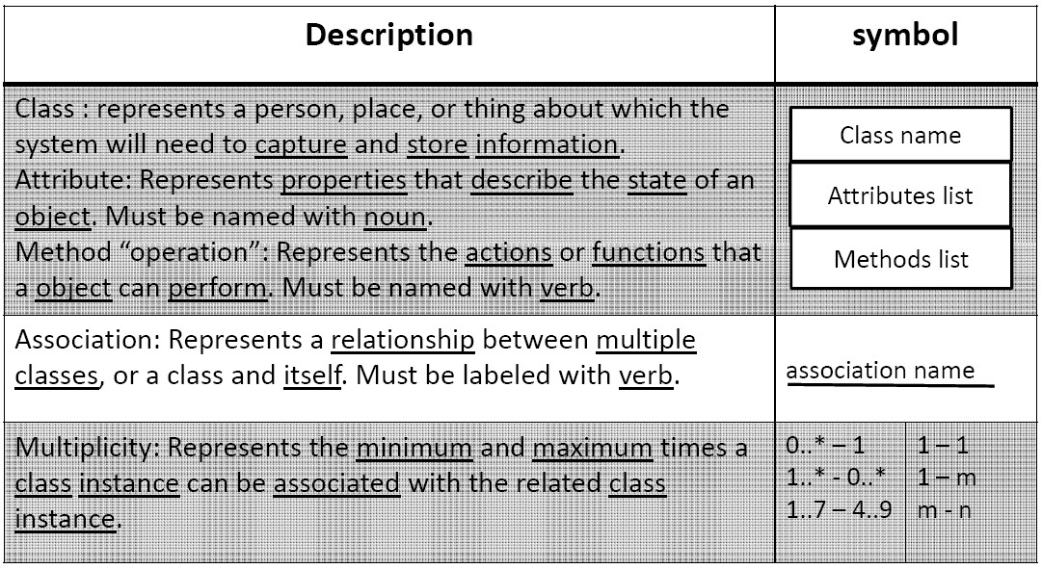

Slide 5
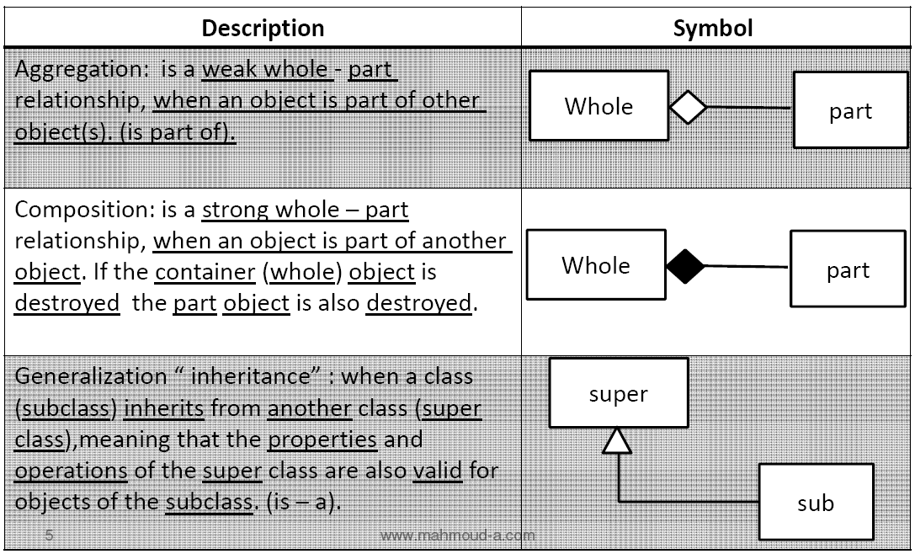

Slide 6



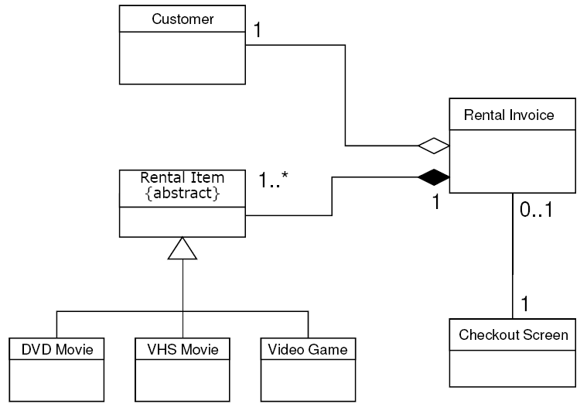

Slide 7
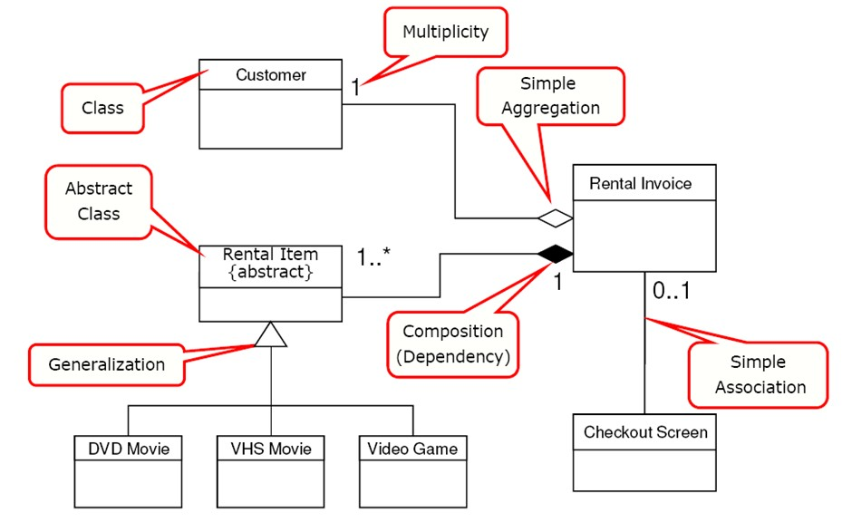

Slide 8
Class diagrams are great for:
discovering related data and attributes
getting a quick picture of the important entities in a system
seeing whether you have too few/many classes
seeing whether the relationships between objects are too complex, too many in number, simple enough, etc.
spotting dependencies between one class/object and another

Slide 9


Slide 10


Draw a class diagram for a information modeling system for a school.
School has one or more Departments.
Department offers one or more Subjects.
A particular subject will be offered by only one department.
Department has instructors and instructors can work
for one or more departments.
Student can enrol in upto 5 subjects in a School.
Instructors can teach upto 3 subjects.
The same subject can be taught by different
instructors.
Students can be enrolled in more than one school.

Slide 11






School has one or more Departments.
School
 |  | Department
1
has
1..*
Department offers one or more Subjects.
A particular subject will be offered by only one department.
Department
 |  | Subject
1
offers
1..*

Slide 12







Department has Instructors and instructors can work
for one or more departments.
Instructor
 |  | Department
1..*
assigned to
1..*
Student can enrol in upto 5 Subjects.
Student
 |  | Subject
*
takes
0..5

Slide 13





Instructors can teach up to 3 subjects.
The same subject can be taught
instructors.
by different
Instructor
 | 1..* | Subjects
teaches
1..3

Slide 14



Students can be enrolled in more than one school.
Student
 | * | School
member
1..*

Slide 15
Department
has
School
1
1..*
1..*
1…*
1
offeres
assignedTo
member
*
1..*
1..*
teaches 1..3 1..*
attends
Instructor
Student
Subject
* 1..5

Slide 16

Object Diagram shows the relationship between objects.
Unlike classes objects have a state.

Slide 17

c1: Company
c1: Company
name=“UniMelb”
d1: Department
d2: Department
name=“Sales”
name=”CSSE”
manager
employee
p1: Persont
p2: Person
name=“Rao”
name=“Raj”

Slide 18


Slide 19
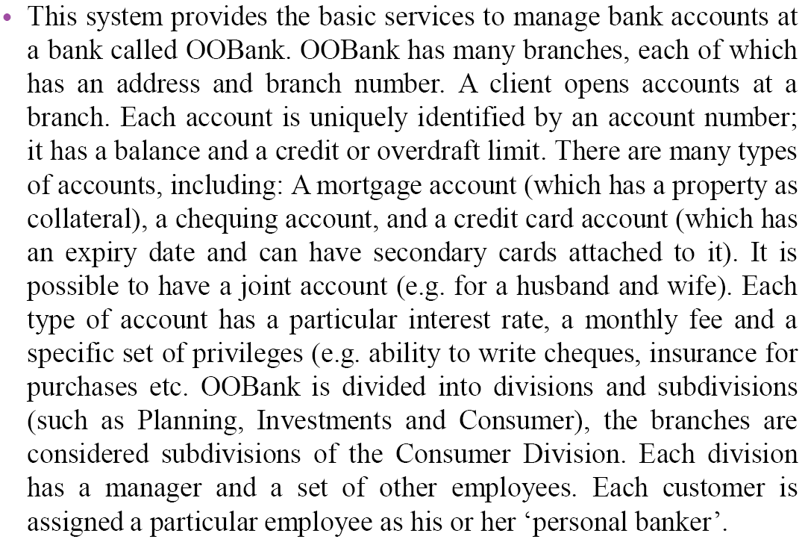

Slide 20

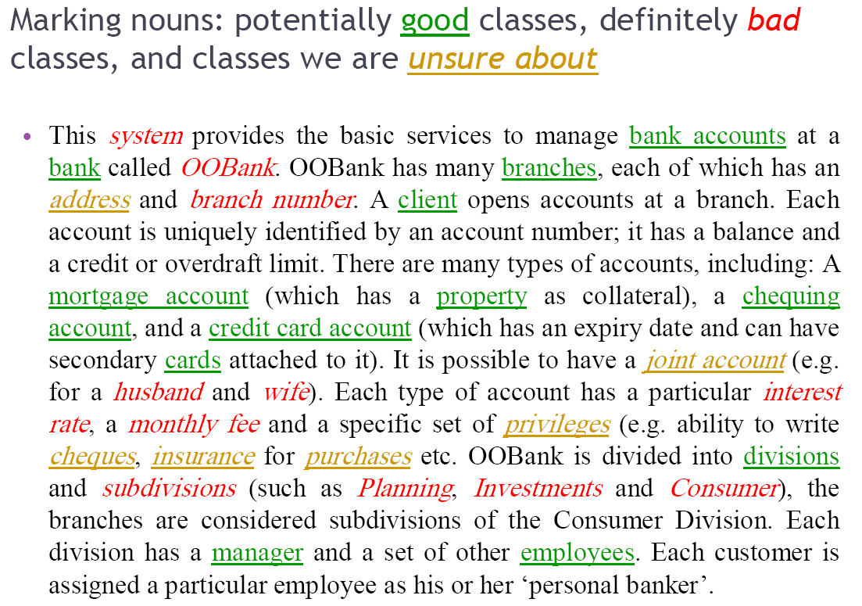

Slide 21










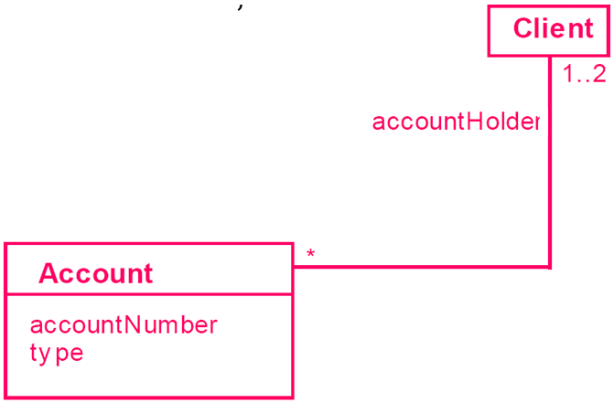

Slide 22




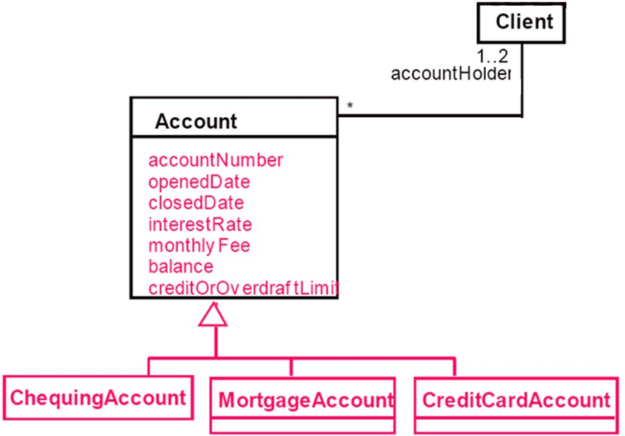

Slide 23







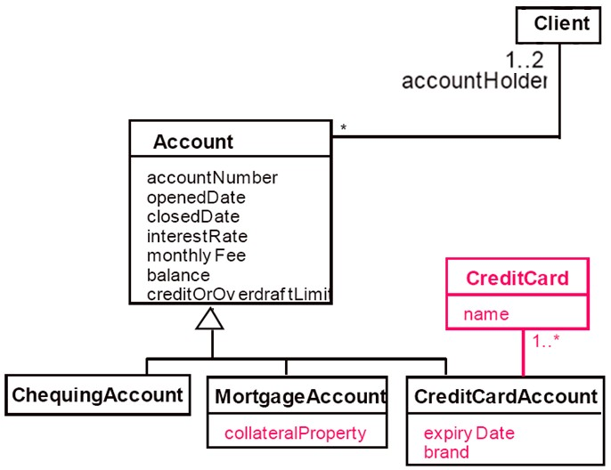

Slide 24

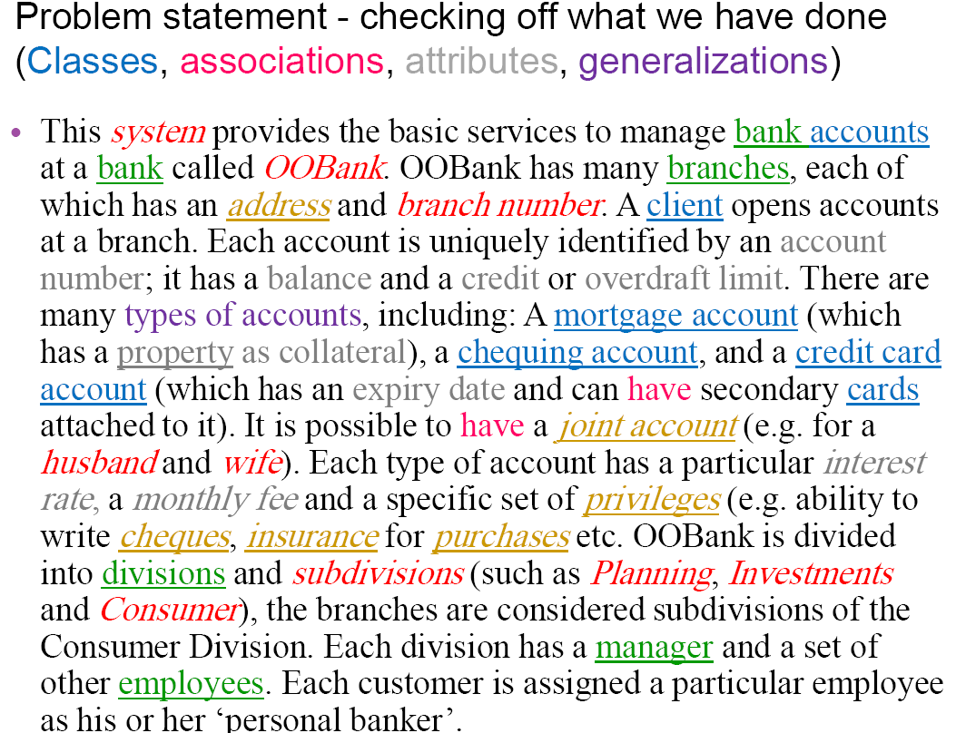

Slide 25







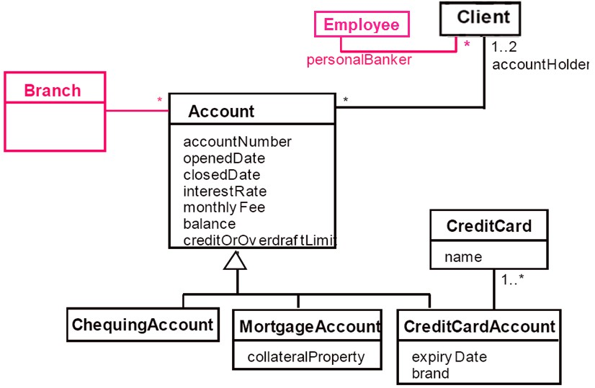

Slide 26
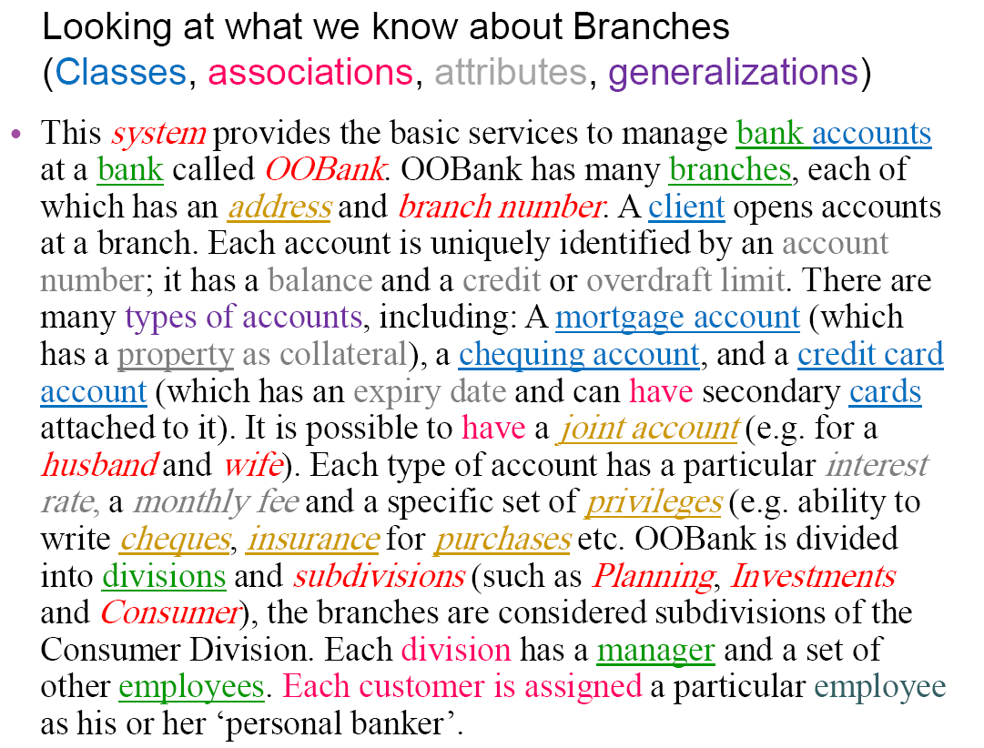

Slide 27






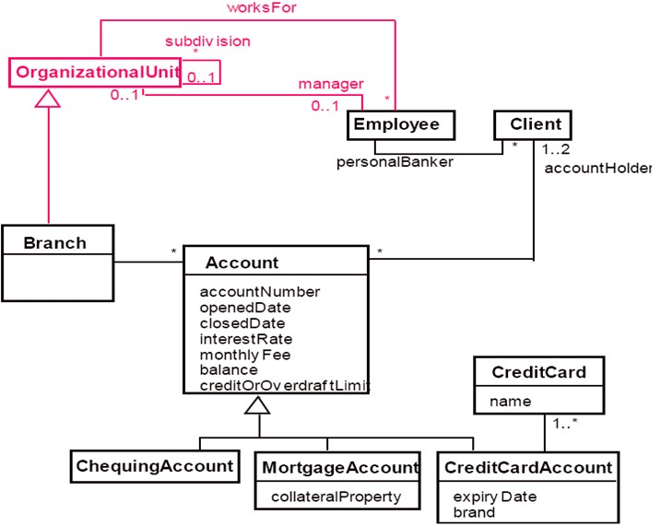

Slide 28
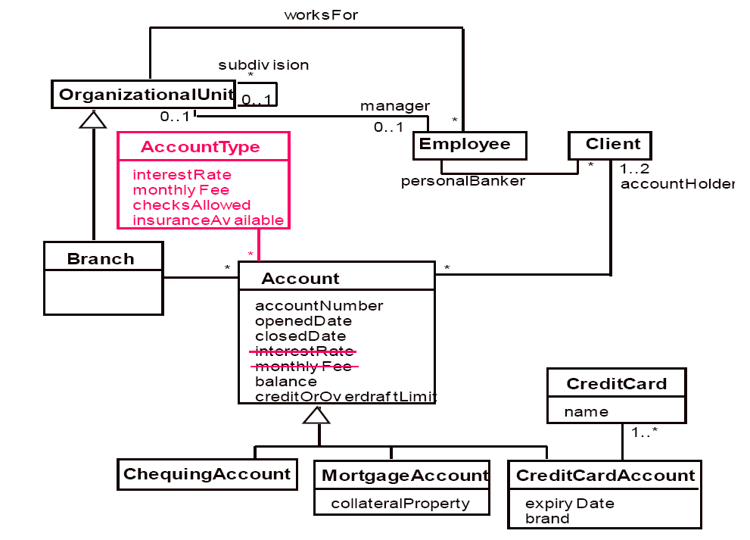

Slide 29
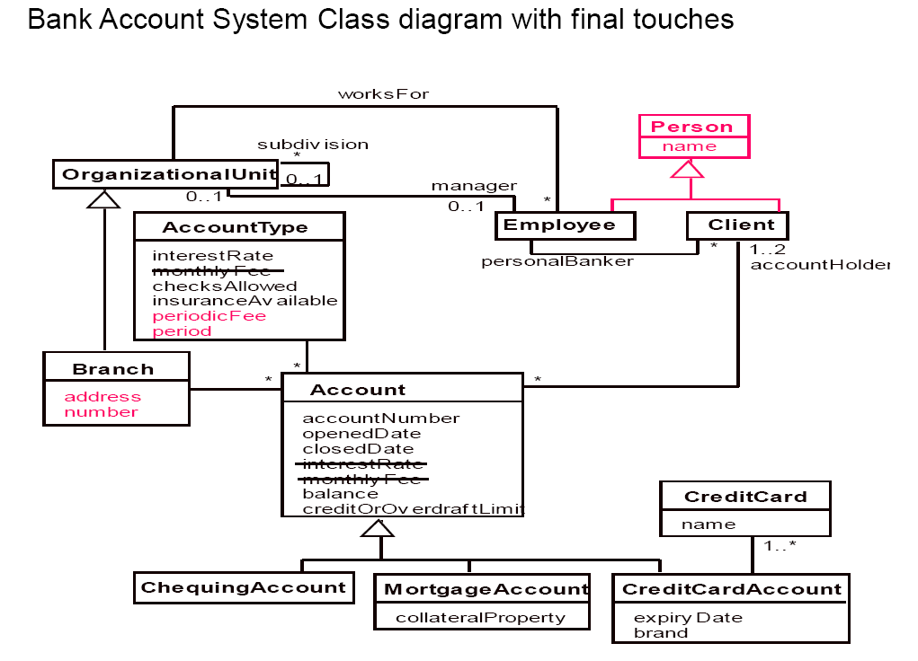

Slide 30






